Slide 1

Motivation: Reward functions for RL may not be well-designed
Objective: compete in the race while staying within the track (yellow dotted lines)
Rewards for:
Finishing the race quickly
Staying on track
Getting close enough to the green objects (gold)
What it learns:
Forget the race, loop around and gather gold

Slide 2
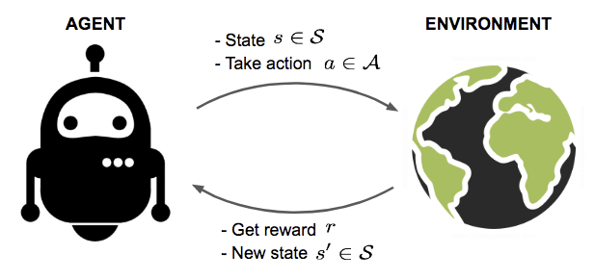
Reinforcement Learning
Current RL/Deep RL methods use state-based rewards

Slide 3
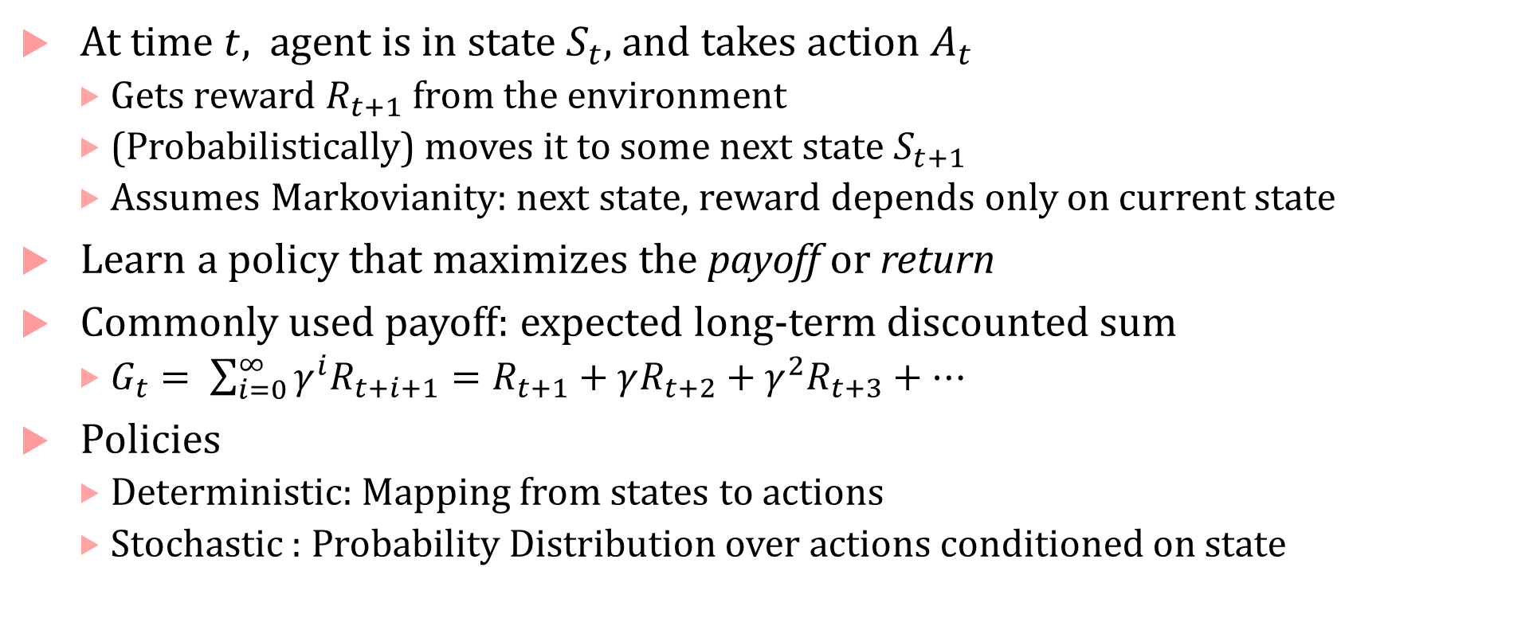
Classic RL on Markov Decision Processes
At time $t$, agent is in state $S_{t}$, and takes action $A_{t}$
Gets reward $R_{t+1}$ from the environment
(Probabilistically) moves it to some next state $S_{t+1}$
Assumes Markovianity: next state, reward depends only on current state
Learn a policy that maximizes the payoff or return
Commonly used payoff: expected long-term discounted sum
$G_{t}= \sum_{i=0}^{∞}{{γ^{i}R}_{t+i+1}}=R_{t+1}+γR_{t+2}+γ^{2}R_{t+3}+…$
Policies
Deterministic: Mapping from states to actions
Stochastic : Probability Distribution over actions conditioned on state

Slide 4
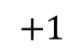
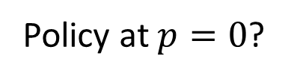
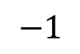
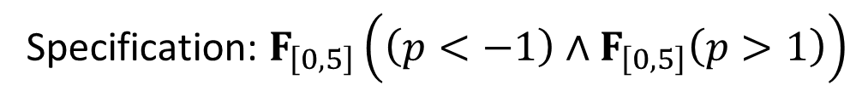
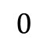
Challenge: Temporal Logic specs induce non-Markovianity
Specification: $F_{\left[0,5\right]}\left(\left(p<−1\right)∧F_{\left[0,5\right]}\left(p>1\right)\right)$
$$−1$$
$$0$$
$$+1$$
States: positions on the number line at 0.1 units,
Actions: Go left 0.1 units, Go right 0.1 units
Policy at $p=0$?

Slide 5
RL from logical specifications
Hot topic!
Several recent papers:
Bruno Lacerda, David Parker, and Nick Hawes. Optimal policy generation for partially satisfiable co-safe LTL specifications. IJCAI 2015.
Meng Guo and Michael M Zavlanos. Probabilistic motion planning under temporal tasks and soft constraints. IEEE TAC 2018.
Ronen Brafman, Giuseppe De Giacomo, and Fabio Patrizi. LTLf/LDLf non-markovian rewards. AAAI 2018.
Mohammadhosein Hasanbeig, Alessandro Abate, and Daniel Kroening. Logically-Constrained Reinforcement Learning. arXiv 2018.
Ernst Moritz Hahn, Mateo Perez, Sven Schewe, Fabio Somenzi, Ashutosh Trivedi, and Dominik Wojtczak. Omega-Regular Objectives in Model-Free Reinforcement Learning. TACAS 2019.
Kishor Jothimurugan, Suguman Bansal, Osbert Bastani, and Rajeev Alur. Compositional Reinforcement Learning from Logical Specifications, NeurIPS 2021.
Krishna C Kalagarla, Rahul Jain, and Pierluigi Nuzzo. Synthesis of discounted-reward optimal policies for Markov decision processes under linear temporal logic specifications, arXiv 2020.
W. Liu, N. Mehdipour, and C. Belta, “Recurrent Neural Network Controllers for Signal Temporal Logic Specifications Subject to Safety Constraints,” IEEE Control Systems Letters, vol. 6, pp. 91–96, 2022, doi: 10.1109/LCSYS.2021.3049917.
C. Sun, X. Li, and C. Belta, “Automata Guided Semi-Decentralized Multi-Agent Reinforcement Learning,” in 2020 American Control Conference (ACC), Jul. 2020, pp. 3900–3905. doi: 10.23919/ACC45564.2020.9147704.
X. Li, Z. Serlin, G. Yang, and C. Belta, “A formal methods approach to interpretable reinforcement learning for robotic planning,” Science Robotics, vol. 4, no. 37, Dec. 2019, doi: 10.1126/scirobotics.aay6276.
X. Li, Y. Ma, and C. Belta, “Automata-Guided Hierarchical Reinforcement Learning for Skill Composition,” arXiv:1711.00129 [cs], May 2018, Accessed: Dec. 12, 2021. [Online].

Slide 6
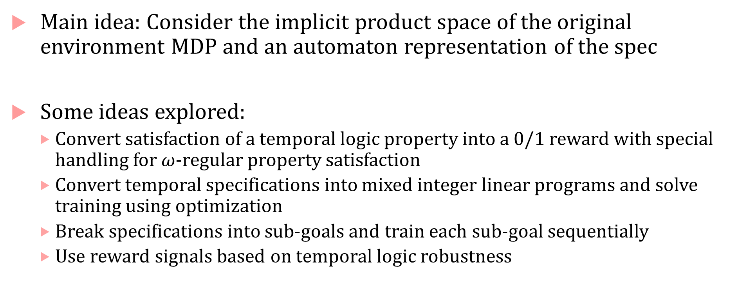
RL from Logical Specifications (LTL, STL, MTL)
Main idea: Consider the implicit product space of the original environment MDP and an automaton representation of the spec
Some ideas explored:
Convert satisfaction of a temporal logic property into a 0/1 reward with special handling for $ω$-regular property satisfaction
Convert temporal specifications into mixed integer linear programs and solve training using optimization
Break specifications into sub-goals and train each sub-goal sequentially
Use reward signals based on temporal logic robustness

Slide 7
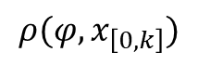
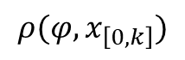
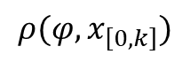
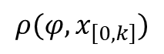
Bounded horizon nominal robustness [IROS 2019]
Robust satisfaction semantics, but interpreted over a bounded horizon (ala MPC)
During RL procedure:
Compute the robust satisfaction over k-step trajectory fragment rollout
Use that as a reward
Intuition: we want to reward satisfying the STL formula over the rollout horizon and penalize not satisfying it
$$ρ(φ, x_{\left[0,k\right]})$$
$$ρ(φ, x_{\left[0,k\right]})$$
$$ρ(φ, x_{\left[0,k\right]})$$
$$ρ(φ, x_{\left[0,k\right]})$$
Balakrishnan, Anand, and Jyotirmoy V. Deshmukh. "Structured reward shaping using signal temporal logic specifications." 2019 IEEE/RSJ International Conference on Intelligent Robots and Systems (IROS). IEEE, 2019.

Slide 8
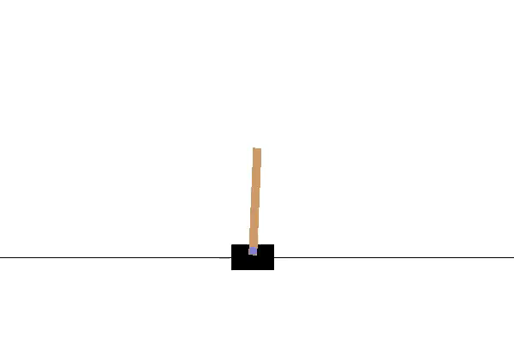
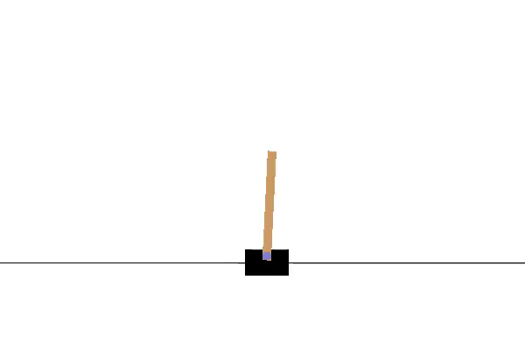
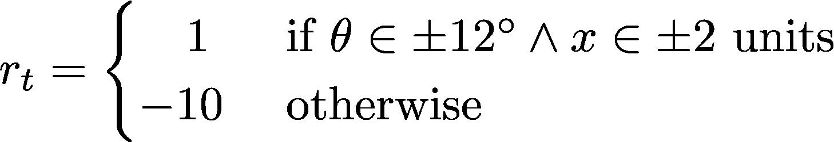
Robustness-guided RL experiment
Vanilla RL Agent: Iteration 729
STL-reward shaped RL Agent: Iteration 343
$$φ=Always \left( Eventually \left(\left|\dot{x}\right|<0.01∧\left|θ\right|<2^{∘}∧\left|x\right|<0.5\right)\right)$$

Slide 9
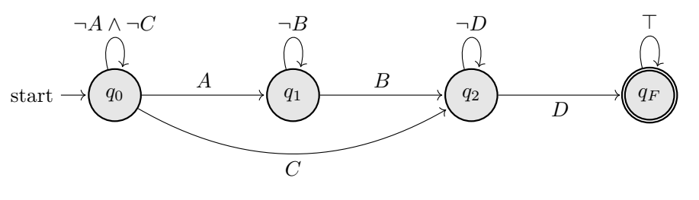
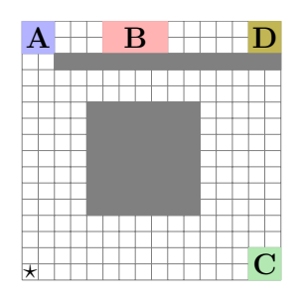
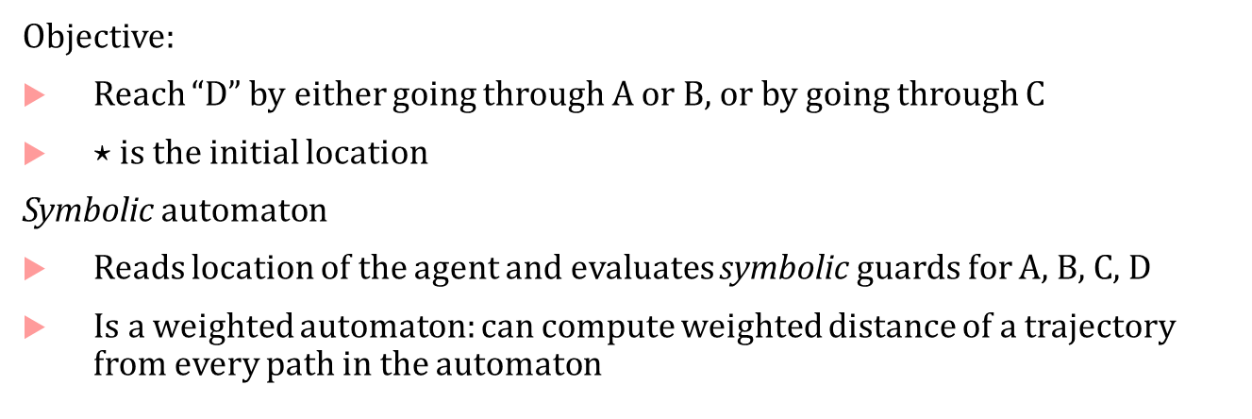
Symbolic Automata based STL specifications
Objective:
Reach “D” by either going through A or B, or by going through C
$⋆$ is the initial location
Symbolic automaton
Reads location of the agent and evaluates symbolic guards for A, B, C, D
Is a weighted automaton: can compute weighted distance of a trajectory from every path in the automaton

Slide 10
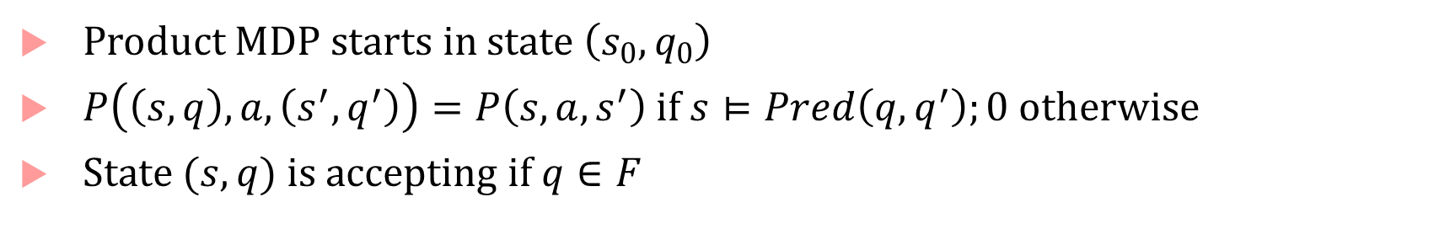
Structure and meaning of a symbolic automaton
Predicates used to evaluate the MDP state
Product MDP starts in state $\left(s_{0},q_{0}\right)$
$P\left(\left(s,q\right),a,\left(s^{′},q^{′}\right)\right)=P\left(s,a,s^{′}\right)$ if $s⊨Pred\left(q,q^{′}\right);0$ otherwise
State $(s,q)$ is accepting if $q∈F$

Slide 11
Reward shaping with symbolic automaton objectives
Three main ideas (details in [1]):
Imagine an implicit product between environment MDP and the symbolic automaton
Quantify how far a state in the product MDP is from an accept state
Define a symbolic potential function that incentivizes moving to a state with lower potential
[1] Anand Balakrishnan, Stefan Jakšić, Edgar A. Aguilar, Dejan Ničković, Jyotirmoy V. Deshmukh, Model-Free Reinforcement Learning for Symbolic Automata-encoded Objectives, https://arxiv.org/abs/2202.02404

Slide 12
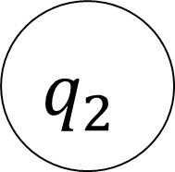
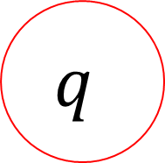
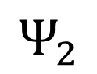
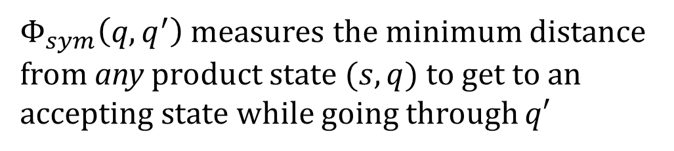

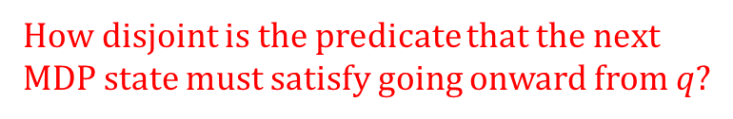
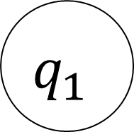
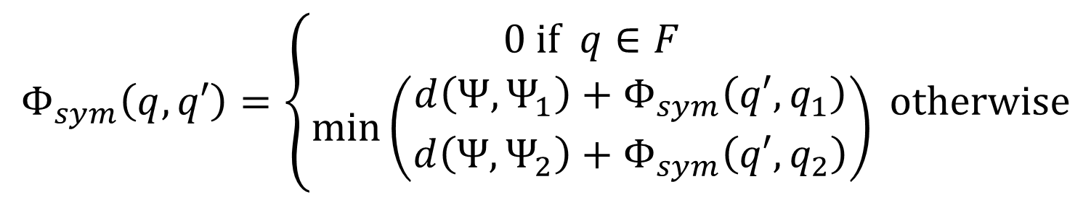
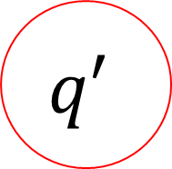
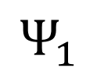
Symbolic Subtask progress $Φ_{sym}\left(q,q′\right)$
$$Φ_{sym}\left(q,q′\right)=\left\{\begin{matrix}0 if q∈F \\ \min\left(\begin{aligned}d\left(Ψ,Ψ_{1}\right)+Φ_{sym}\left(q′,q_{1}\right) \\ d\left(Ψ, Ψ_{2}\right)+Φ_{sym}\left(q′,q_{2}\right)\end{aligned}\right)\end{matrix}\right. otherwise$$
How disjoint is the predicate that the next
MDP state must satisfy going onward from $q$?
$$q$$
$$Ψ$$
$$q′$$
$Φ_{sym}\left(q,q^{′}\right)$ measures the minimum distance from any product state $(s,q)$ to get to an accepting state while going through $q′$
$$Ψ_{1}$$
$$Ψ_{2}$$
$$q_{1}$$
$$q_{2}$$

Slide 13
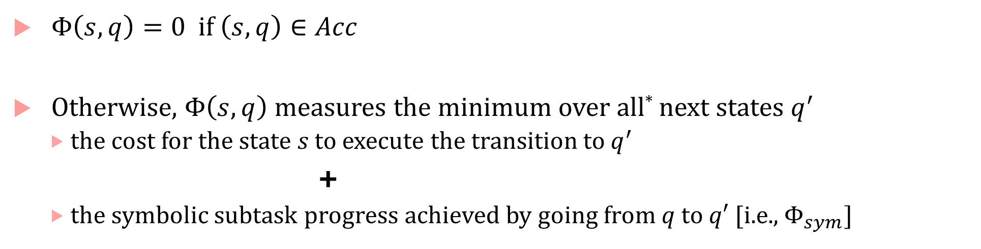
Symbolic Potential Function
$Φ\left(s,q\right)=0$ if $\left(s,q\right)∈Acc$
Otherwise, $Φ\left(s,q\right)$ measures the minimum over all* next states $q^{′}$
the cost for the state $s$ to execute the transition to $q^{′}$
+
the symbolic subtask progress achieved by going from $q$ to $q′$ [i.e., $Φ_{sym}]$

Slide 14
Theorem [1]:
Optimal policy found by an RL algorithm w.r.t. symbolic potential-based reward functions maximizes the probability of satisfying the automaton objective*
*The automaton must have a terminally accepting state, e.g., any finitely bounded horizon STL specification

Slide 15
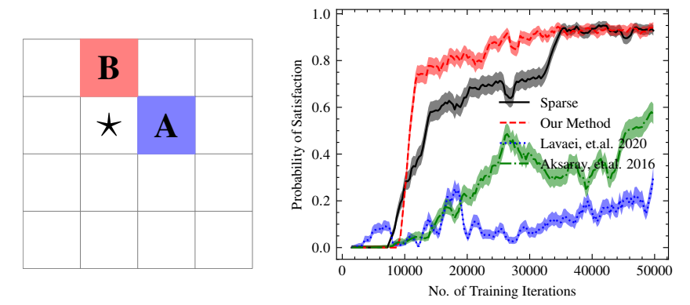
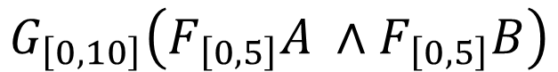
Patrolling
Patrol A and B with hard deadlines
Grid size: 4x4, Q-learning
Automaton has 277 nodes, 757 edges
$$G_{\left[0,10\right]}\left(F_{\left[0,5\right]}A ∧F_{\left[0,5\right]}B\right)$$

Slide 16
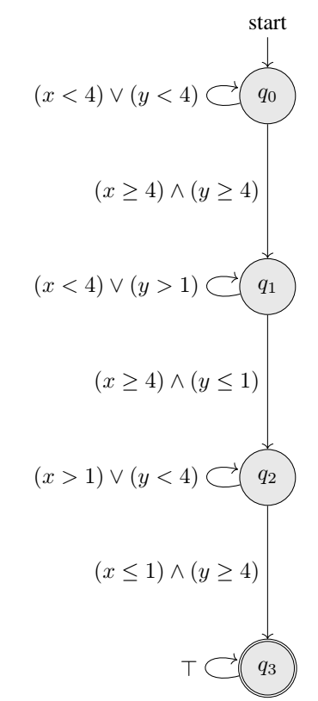
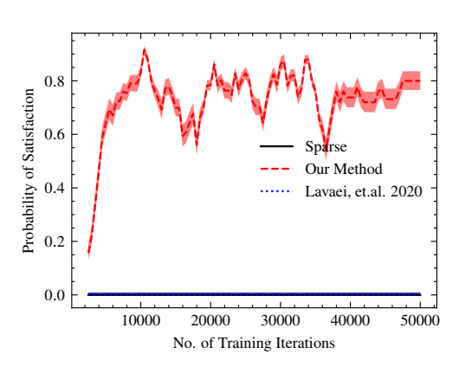
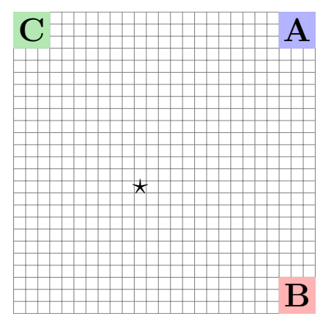
Sequential Reachability
Task: Reach A then B then C
Grid size: 25x25, Q-Learning

Slide 17
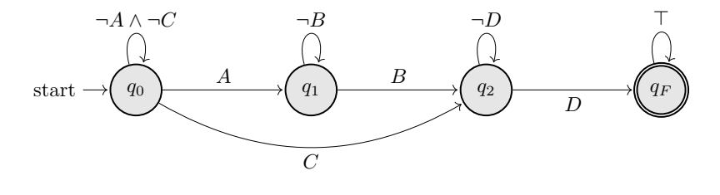
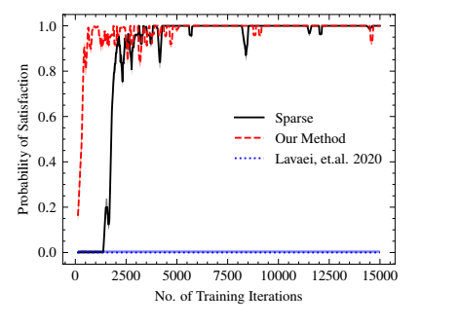
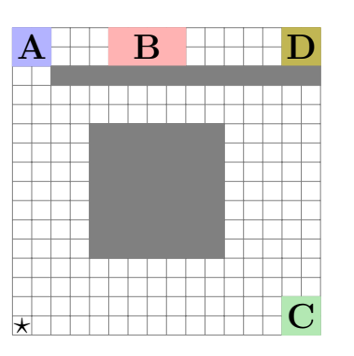
Choice in specifications
Reach D either through C or through A and B
Grid size: 16x16, Q-learning

Slide 18
Next Steps
Larger environments, continuous state and action spaces?
Trying deep RL methods (tuning hyperparameters)
More complex specifications (with temporal nesting), longer time horizons

Slide 19
Learning from Demonstrations

Slide 20
LfD + Temporal Logic objectives
Philosophy: Give demos and high-level task objectives in your favorite temporal logic
If you have demonstrations, why do you need TL?
Most methods require human experts to give perfect demonstrations; humans are imperfect
Autonomous agent can only infer the desired intent from demonstrations
May require many demonstrations to learn close-to-optimal policy
If you have TL specs, why not just do reactive synthesis?
May require complete set of specifications, model of agent and environment dynamics
May be computationally intractable
TL specs give what to accomplish ; Demos give partial glimpse into how to accomplish

Slide 21
Challenge: Many specs & sub-optimal, noisy demonstrations
There may be several specifications user wants to satisfy
Hard constraints specifying safety requirements
Soft constraints specifying performance objectives
Demonstrations may not be optimal
Demo could be just a non-demo (e.g., demonstrating a crash)
Demo may be sub-optimal (everyone in the race laps you twice)
Environments could be stochastic
State, Action spaces may be continuous

Slide 22
Reward Inference from good and bad demonstrations
Idea 1:
D.a.g. that encodes relative priorities between specs: used to infer weights to use on specifications
Reward for states appearing in a demo is a weighted sum of spec robustness
Implicitly defines a priority/preference-aware desirability metric to rank demos
Idea 2:
Use function approximation (neural networks) to extend reward values to unexplored states and use environment stochasticity to reward “nearby” demos

Slide 23
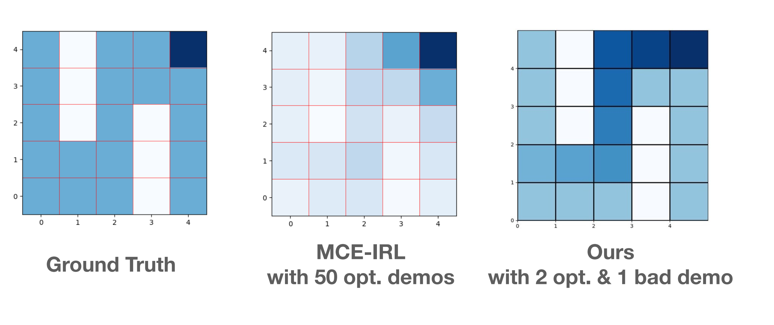
Learning from Demonstrations: case studies
Additional information from specifications dramatically improves sample complexity

Slide 24
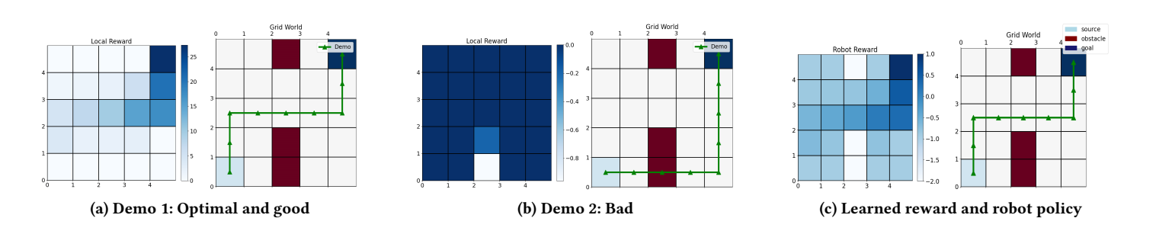
LfD: case studies
STL-based ranking of demonstrations allows demonstrations to be incomplete/bad

Slide 25
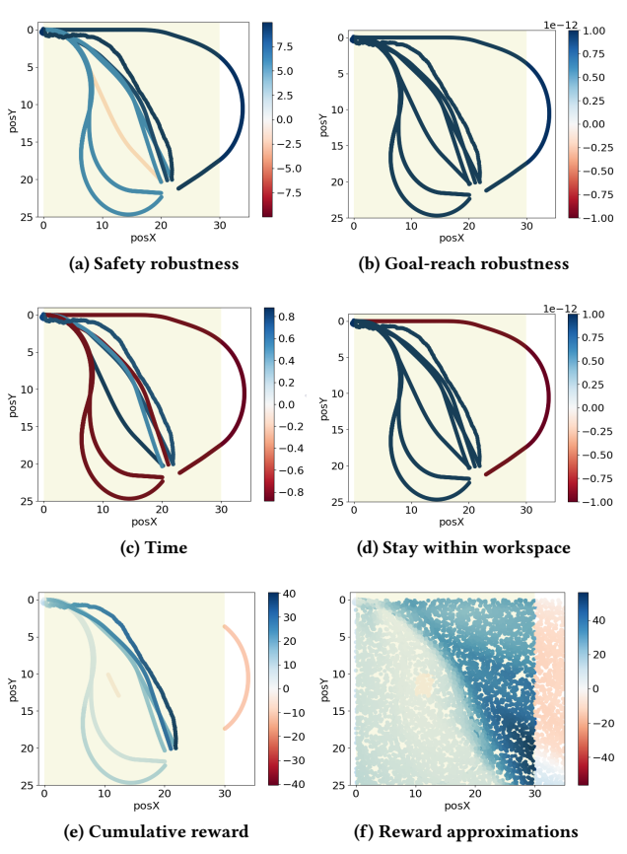

LfD : case studies
STL-based priority-aware ranking of demonstrations + NN/GP allows generalization in continuous, stochastic spaces

Slide 26
Next Steps
Using Quality-Diversity algorithms for generating demonstrations
Demonstrations using HSR, other robot simulators

